Slide 1
Self Introduction:
Good Evening, I am Vinay from Bangalore. I work for HCL technologies, Bangalore. Started career as stress analyst in Safran Engineering services and worked for approx., 4yrs. In 2013, started as technical lead and worked in supply chain procurement, Aftermarket Sale, Aftermarket Technical Services & Aerospace domain.
Involved in Governance meeting, team management, Training, Dashboard Creation, Automation, Data analysis, Internal Benchmarking, spend analytics under MBBP framework, scrum meeting, customer interaction.
Regarding skillsets, I have extensively worked with Advance excel, Power Pivot, Power Query, VBA, Power BI, Access DB. And intermediate level of python and SQL queries.
Roles & Responsibilities:
Handling team of 2, Customer interaction, Training, Gathering information

Slide 2
Project worked in Should costing or aPriori:
Explain about Baker Heads, CAD drawing from windchill, VPE, Cost estimation,
Challenges faced while executing:
Gears – There were no proper VPE, customer used to purchase the commodity at $1000-$1200. China Supplier were giving same gears for $200 - $250. But, in aPriori it was giving as $500 - $600. Then we did manual calculation by consulting with experts
Example project worked in Spend Analytics:
Copper Tube → Extract all specs by RFI,
Challenges faced while executing:
Suppliers were not responding quickly, e-Auction bidding to gather all, E-Auction bidding was conducted in GEP software
Linear Regression project worked: Sheet Metal → Based on thickness
Challenging project worked in cost saving: Automation (A1 Analysis), Stress- Repair Tool, VAVE global procurement tool.
Give an example of cost saving in daily life: Purchasing daily needs like vegetables, milk, etc. Negotiating with vendor.
Positives/Negatives: Keep updating skillsets.
Focus on one project at a time.
Hobbies: Badminton, Reading Books,
Sites used for Online prices : Alibaba.com, McMaster

Slide 3
What are the costs while doing should costing → Material Cost, Labor cost, overhead Cost, Amortization Cost
Maximum cost while performing should costing → Material Cost
Explain about any aPriori project → Dish Heads, Realised savings of $3M

Slide 4
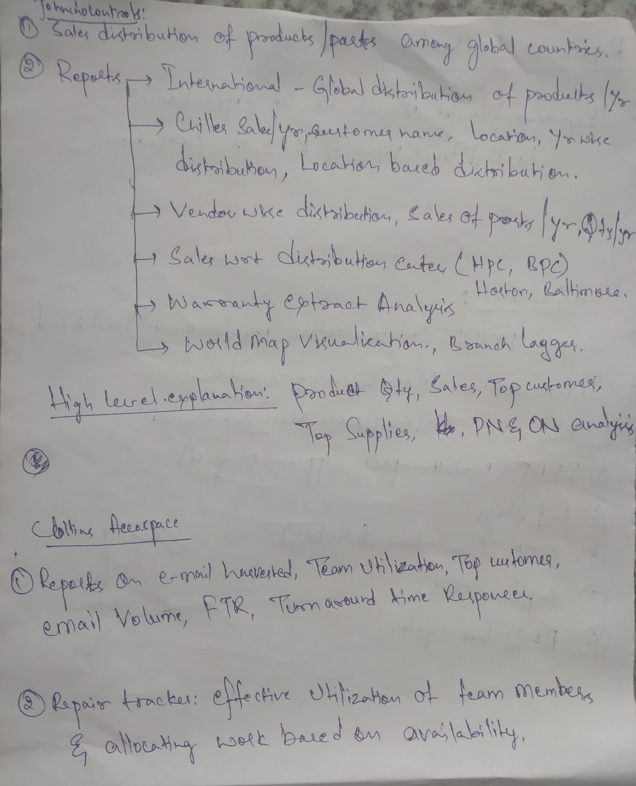
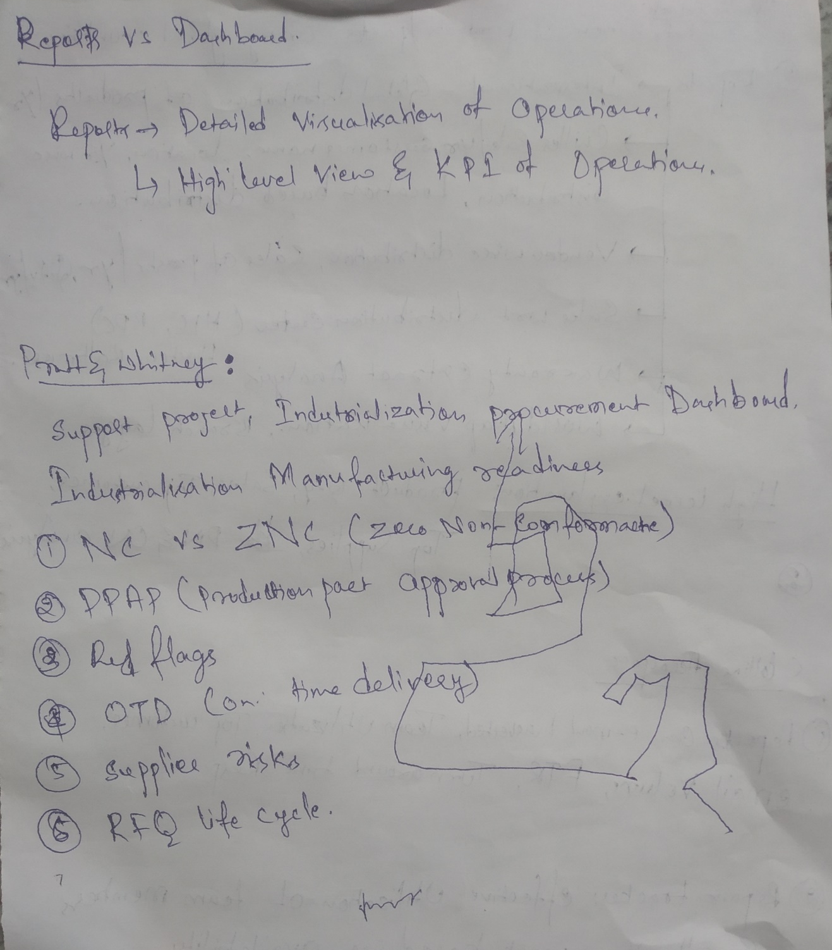
Power BI Projects Handled

Slide 5
1. Why are you looking for change in Job?
I am looking for better Opportunities in career.
2. Why do you need this job?
3. If team is struggling in completing the task. What do you do?
4. How do you prioritize the work?
5. How to automate to run the python script to run on daily basis?
6. Steps of data analysis in Excel?
7. Difference between using formula and VBA. When do you use Excel formula and VBA Macros?
8. How do you create value addition to the team if you are provided with new domain
9. Suppose if new work is assigned to you, how will you approach.
10. What is your role and Responsibilities.

